Slide 1


Aby Joe Jose
06/17/2025

Slide 2

Outline
Executive Summary
Introduction
Methodology
Results
Conclusion
Appendix

Slide 3

Executive Summary
The methodologies included in the project are data collection through web scraping, data wrangling, EDA , Visualization in dashboard and model building using multiple predictive models.
Most of the models show identical results on rest data with and accuracy score of 83.33% for all the models on test data.
But decision tree model had the highest accuracy with 88.88%

Slide 4

Introduction
Project background is to determine the cost of the launch of falcon 9 rocket Launchers.
The problem statement is that the cost id dependent on the fact that whether the first stage of the rocket will land safely.
So, if we could predict whether the outcome of the first stage of the launch we can anticipate the cost of the launch. This surely will benefit the stakeholders.

Slide 5

Section 1

Slide 6

Methodology
Executive Summary
Data collection methodology:
Data is collected using APIs and web scraping using Beautiful Soup package from Wikipedia.
Perform data wrangling
After extraction data was checked for the percentages of missing data and cleaned for processing.
Perform exploratory data analysis (EDA) using visualization and SQL
Perform interactive visual analytics using Folium and Plotly Dash
Perform predictive analysis using classification models

Slide 7
Data Collection
Data was collected by connecting to the dataset using APIs.
And was converted to a JSON file which was then converted to a Data frame.
Data was also collected from Wikipedia using web scraping
All HTML table content was extracted from the site.

Slide 8
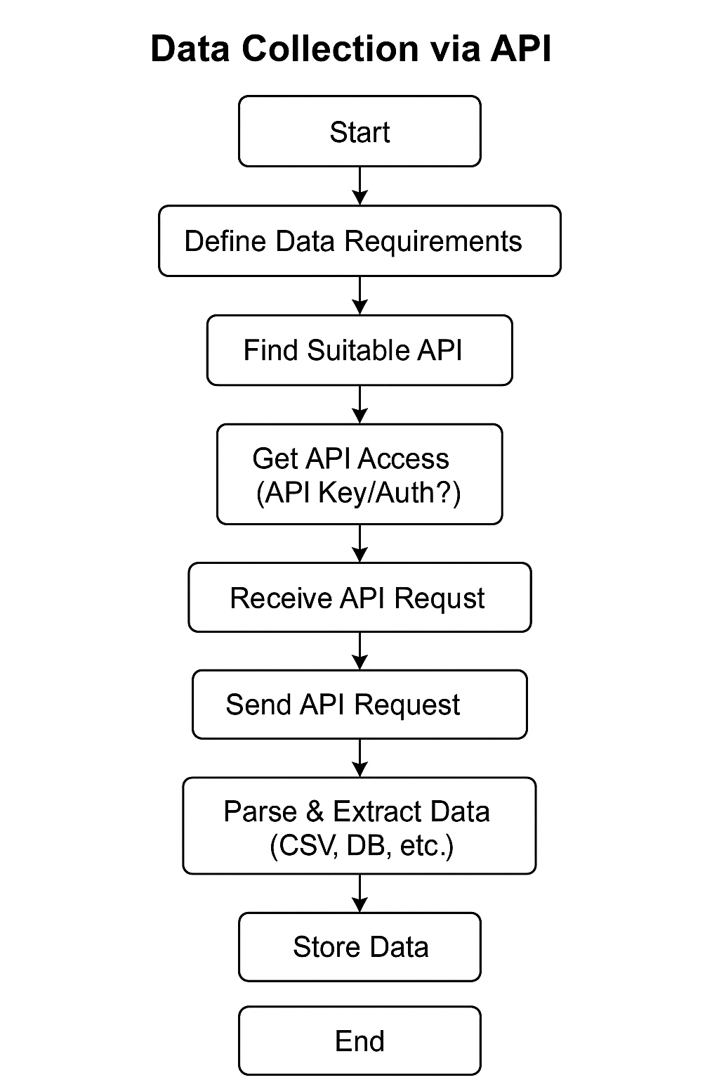
Data Collection – SpaceX API
This is the flow chart of data collection using API
testrepo/jupyter-labs-spacex-data-collection-api.ipynb at main · AbyJoeJose/testrepo

Slide 9
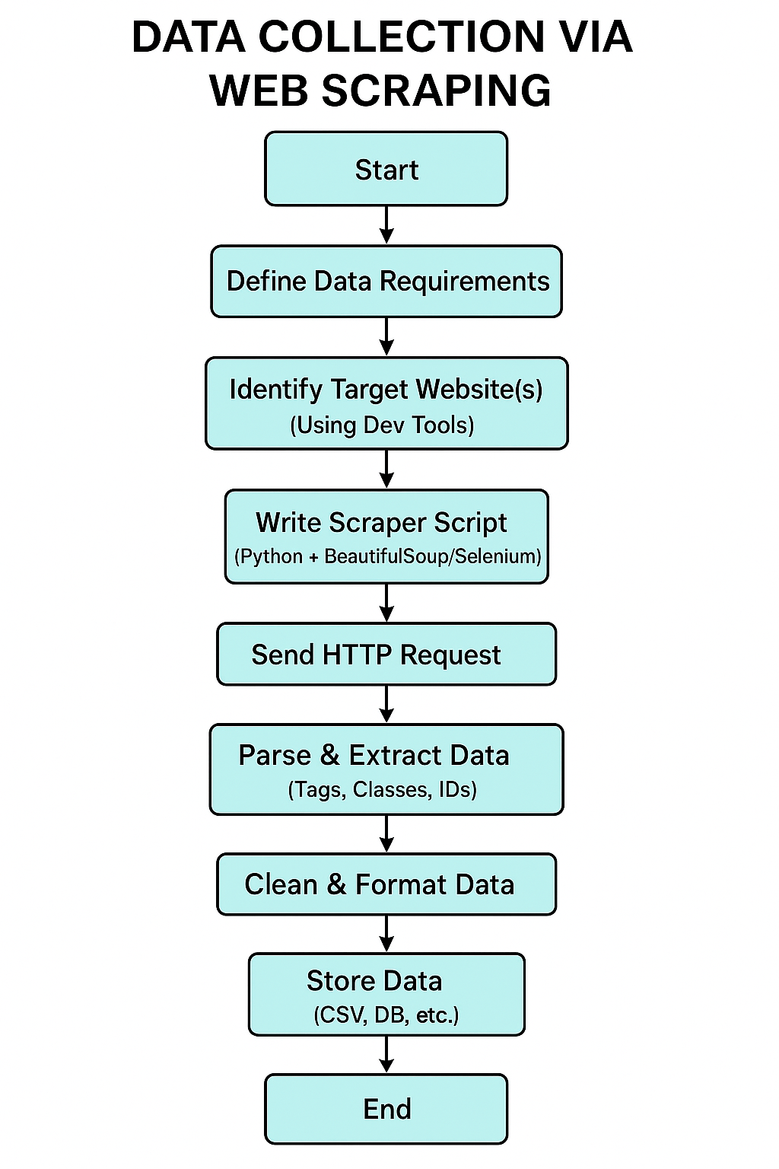
Data Collection - Scraping
This is the flow chart of Web scraping
testrepo/jupyter-labs-webscraping.ipynb at main · AbyJoeJose/testrepo

Slide 10
Data Wrangling
The data was first checked for missing values
The missing values of Landing Pad was replaced with the mean of the column.
The number of Launches on each site were also checked
The number and occurrence of each object were checked
As well as for the mission outcomes and landing outcomes
testrepo/labs-jupyter-spacex-Data wrangling.ipynb at main · AbyJoeJose/testrepo

Slide 11
EDA with Data Visualization
Cat plot was used to visualize the relationship between flight number and launch sites with color as class outcome. It clearly visualizes the outcome on each launch sites.
Scatterplot was used to visualize payload mass and launch site with class as color. It clearly visualizes the outcome on each launch sites.
Bar plot was used to check the success rate of each orbit type. Best way to simply show the categorical data
Scatter plot with flight number and orbit was used to show the flight number of the orbits clearly. In the same way Payload mass and orbit type was also plotted
Lauch success by year was plotted using a line plot which shows an increase over the years
Dummy variables were created for categorical variables.
testrepo/edadataviz.ipynb at main · AbyJoeJose/testrepo

Slide 12
EDA with SQL
The names of the launch sites were displayed.
5 records of launch sites beginning with ‘CCA’ were recorded
Average payload mass of booster F9 v1.1 was 2928.4
The first date of successful landing outcome in ground pad was 2015-12-22
There were 5 Booster versions with payload mass between 4000 and 6000
The total number of mission outcome for success was 98
testrepo/jupyter-labs-eda-sql-coursera_sqllite.ipynb at main · AbyJoeJose/testrepo

Slide 13
Build an Interactive Map with Folium
Markers were made on the graph where the launch sites were located
Clusters were made on the launch sites to group the green as successful launch and red as unsuccessful launch
Lines with distance are plotted to see how much distance the launch sites are from the nearest shore, city and highway.
testrepo/lab_jupyter_launch_site_location.ipynb at main · AbyJoeJose/testrepo

Slide 14
Build a Dashboard with Plotly Dash
The inputs are set to Launch sites and as per the input the pie chart shows the success rate of each launch site
A scatter plot will also show the correlation between the Payload mass and success in which the payload mass range can be altered
The plots show the success rate the Relation with payload mass in an interactive and robust way.
Dash
testrepo/Plotly.ipynb at main · AbyJoeJose/testrepo

Slide 15
Predictive Analysis (Classification)
The models were built by splitting the data into train-test with a percentage of 20 being the testing data.
Models like logistic regression, SVM, Decision Tree, KNN were used for prediction.
All the models showed identical results in the test data with an accuracy of 83.33% and same way of correct classification and miss classification.
But the decision tree model showed more accuracy on training data as well
testrepo/SpaceX_Machine Learning Prediction_Part_5.ipynb at main · AbyJoeJose/testrepo

Slide 16
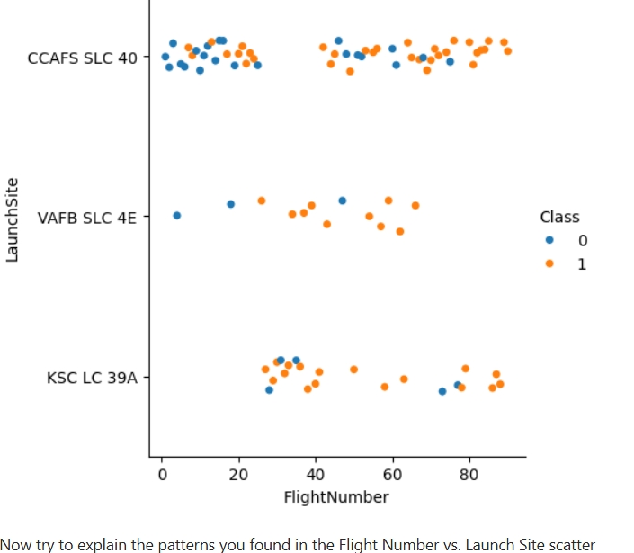
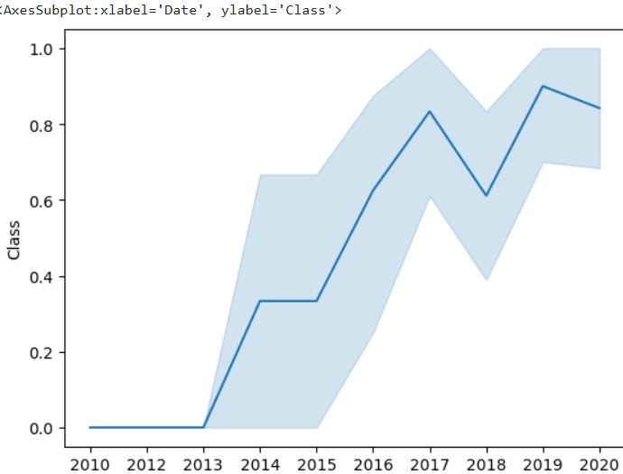
Results
From EDA
we can see that CCAFS SLC 40 had more success than others while they also has more failures that others
Low payload mass showed more success.
Orbits like ES-L1,GEO,HEO and SSO showed good success rate of 1
The success rate is climbing over the years with 2019 being the most successful year

Slide 17
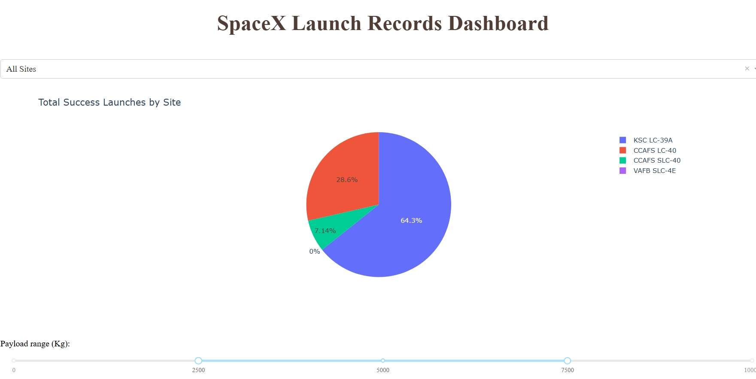
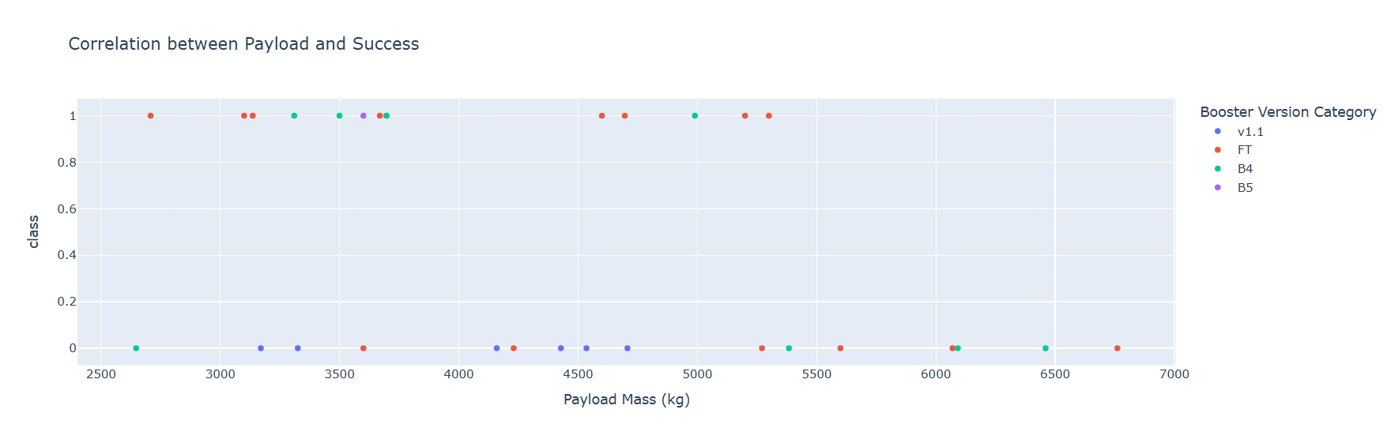
Results
Interactive analytics
Shows that the overall success rate is high for KSC LC-39A but only few launches were done on that site with a rate of 43.7% when all the payload range was considered
Payload Range of 2500 to 7500 is apt for KSC LC-39A as the success rate sky rocked to 64.3%
But at this range of 2500 to 7500 no rate is there for VAFB SLC-4E

Slide 18
Results
Predictive Analysis
Shows Identical accuracy on test data for all the predictive models with an accuracy of 83.33% on test data.
Decision tree had the highest accuracy in test data with 88.88%
Other models had almost the same accuracy.

Slide 19

Section 2

Slide 20
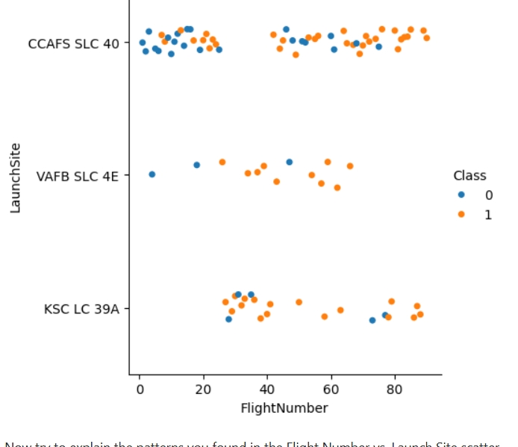
Flight Number vs. Launch Site
Scatter plot of Flight Number vs. Launch Site
We can see that CCAFS SLC 40 had more success than others while they also has more failures that others
While more success rate is for VAFB SLC 4E

Slide 21
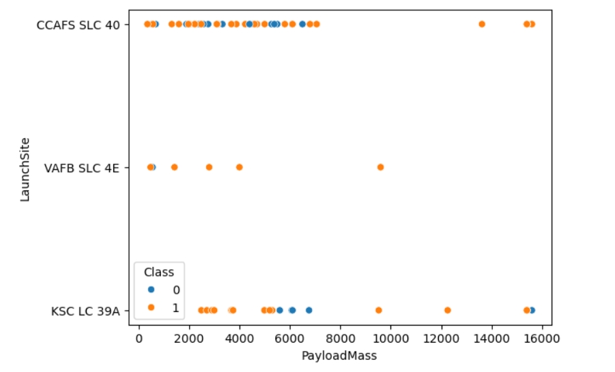
Payload vs. Launch Site
Scatter plot of Payload vs. Launch Site
More success is for the ones that have low payload mass less than 6000

Slide 22
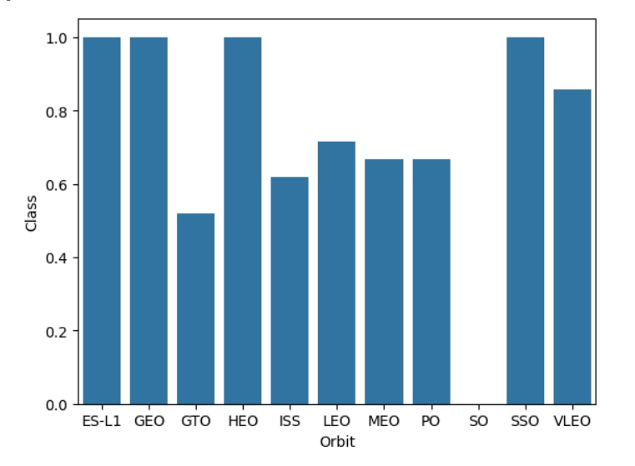
Success Rate vs. Orbit Type
Bar chart for the success rate of each orbit type
Bar graph shows that the success rate is great for the ones in the orbit ES-L1,GEO,HEO and SSO

Slide 23
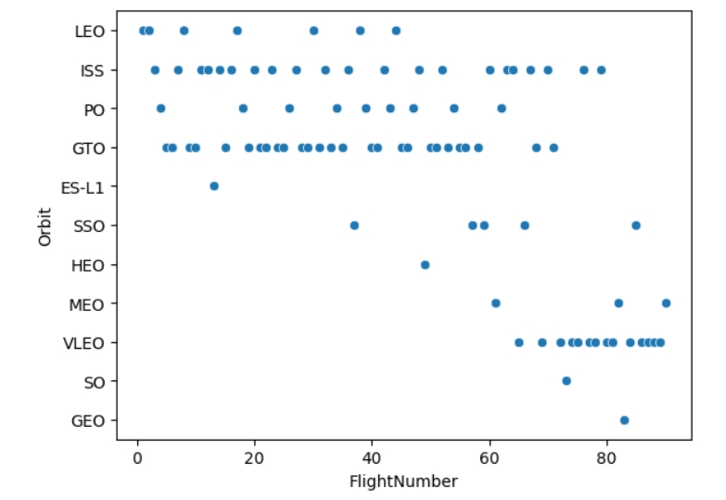
Flight Number vs. Orbit Type
Scatter point of Flight number vs. Orbit type
Shows that the lower flight number is for the orbits LEO,PO and GTO
Higher flight number density can also be seen for orbit VLEO

Slide 24
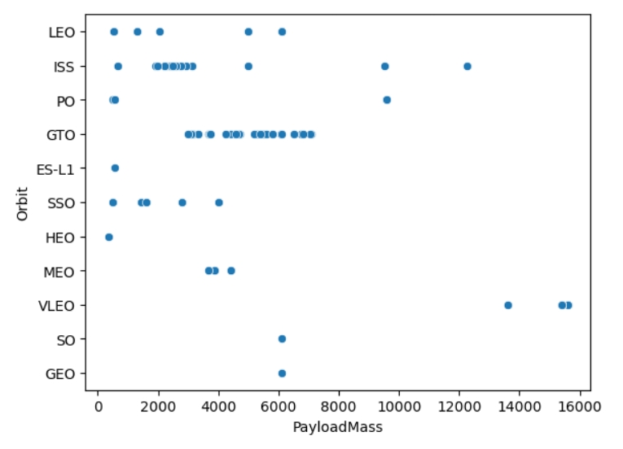
Payload vs. Orbit Type
Scatter point of payload vs. orbit type
Lower pay load mass orbits in the orbit ISS
And the orbit GTO have a payload mass range of 3800 to 8000

Slide 25
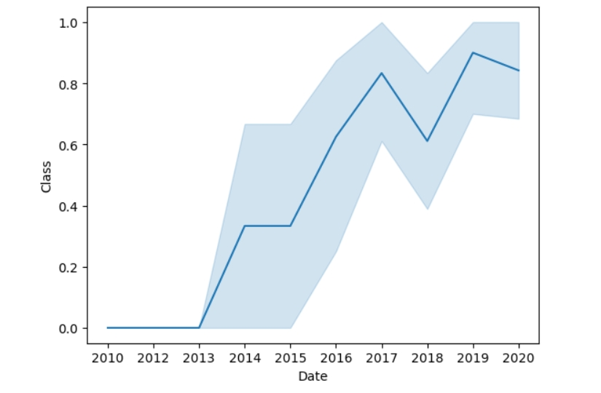
Launch Success Yearly Trend
Line chart of yearly average success rate
Line chart shows an increase in the success rate over the years.
With highest being 2019

Slide 26
All Launch Site Names
The names of the unique launch sites are shown below:
The query results gives the unique names of the launch sites
Query -
CCAFS LC-40
VAFB SLC-4E
KSC LC-39A
CCAFS SLC-40
%sql SELECT DISTINCT Launch_Site FROM SPACEXTABLE

Slide 27
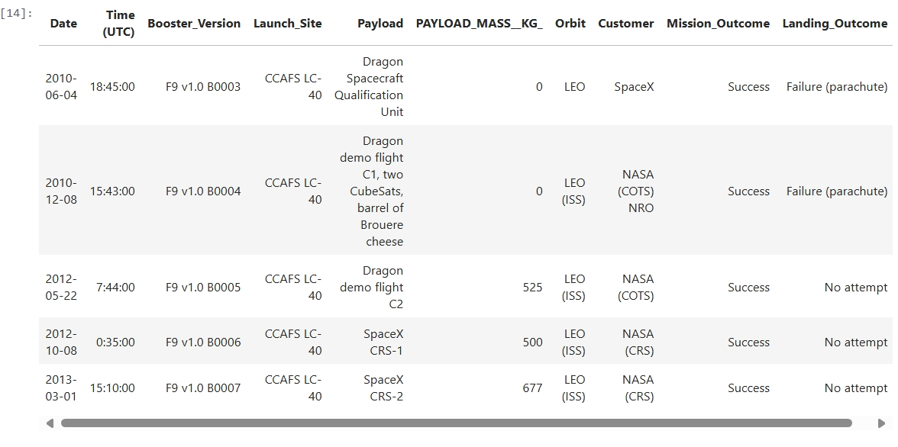
Launch Site Names Begin with 'CCA'
The 5 records where launch sites begin with `CCA` are :
The query gives the complete records of the launch sites that begin with ‘CCA’
Query -
%sql SELECT * FROM SPACEXTABLE WHERE Launch_Site LIKE 'CCA%' LIMIT 5

Slide 28
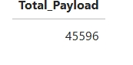
Total Payload Mass
The total payload carried by boosters from NASA is 45596
Query result :
The query gives the total payload of the customer NASA (CRS)

Slide 29
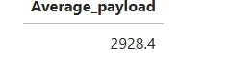
Average Payload Mass by F9 v1.1
The average payload mass carried by booster version F9 v1.1 is 2928.4
The result:
The query gives the average payload of the booster version F9 v1.1
Query: %sql SELECT AVG(PAYLOAD_MASS__KG_) as Average_payload FROM SPACEXTABLE WHERE Booster_Version ='F9 v1.1

Slide 30
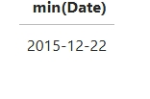
First Successful Ground Landing Date
The dates of the first successful landing outcome on ground pad is 2015-12-22
The result:
The Query:%sql SELECT min(Date) FROM SPACEXTABLE WHERE Landing_Outcome = 'Success (ground pad)'

Slide 31
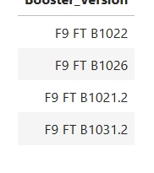
Successful Drone Ship Landing with Payload between 4000 and 6000
The names of boosters which have successfully landed on drone ship and had payload mass greater than 4000 but less than 6000 are
The query displays the payload mass between the range of 4000 and 6000
The query: %sql SELECT Booster_Version FROM SPACEXTABLE WHERE (PAYLOAD_MASS__KG_>4000) and (PAYLOAD_MASS__KG_<6000) and Landing_Outcome = 'Success (drone ship)'

Slide 32
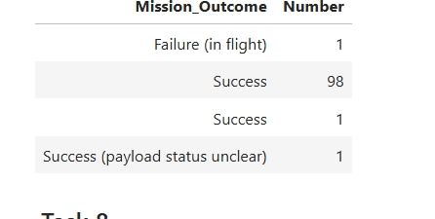
Total Number of Successful and Failure Mission Outcomes
The total number of successful and failure mission outcomes
The query gives the results and the list shows that the success is 98 for the category in the mission outcome.

Slide 33
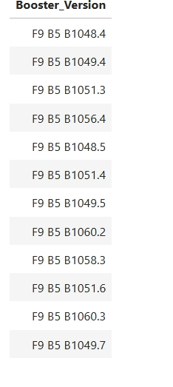
Boosters Carried Maximum Payload
The names of the booster which have carried the maximum payload mass
It shows all the booster version in the correct order.

Slide 34
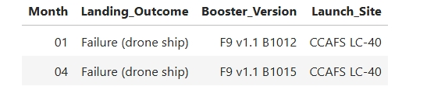
2015 Launch Records
The failed landing outcomes in drone ship, their booster versions, and launch site names for in year 2015
The outcomes displays the month, landing outcome , booster version and the respective launch site.

Slide 35
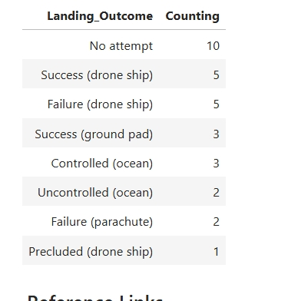
Rank Landing Outcomes Between 2010-06-04 and 2017-03-20
Ranking the count of landing outcomes (such as Failure (drone ship) or Success (ground pad)) between the date 2010-06-04 and 2017-03-20, in descending order
It shows the failure of drone ship between the given dates in descending order

Slide 36

Section 3

Slide 37
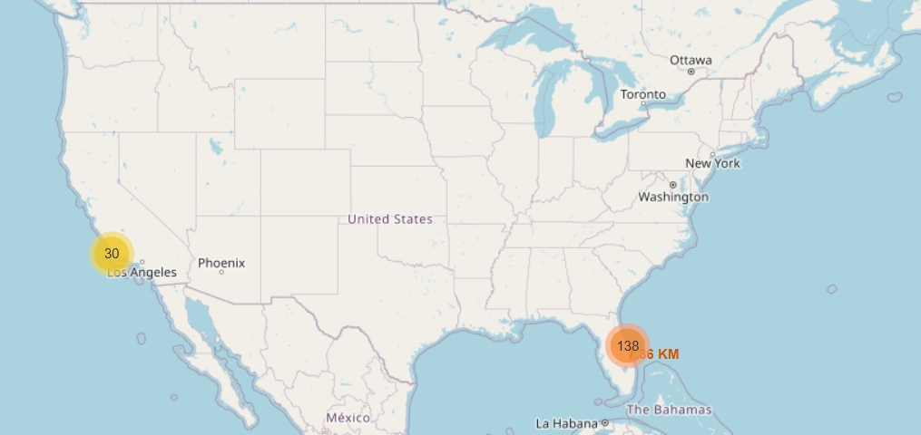
Map of the launch sites
The map shows the launch sites on the map with its cluster group

Slide 38
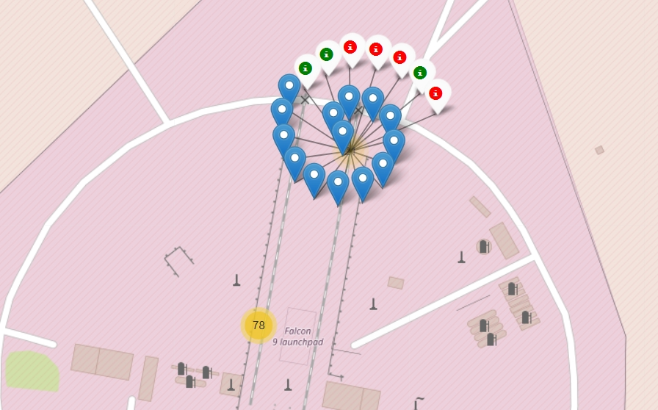
Color labeling of the outcome
This shows the red with failed and green with successful outcomes.

Slide 39
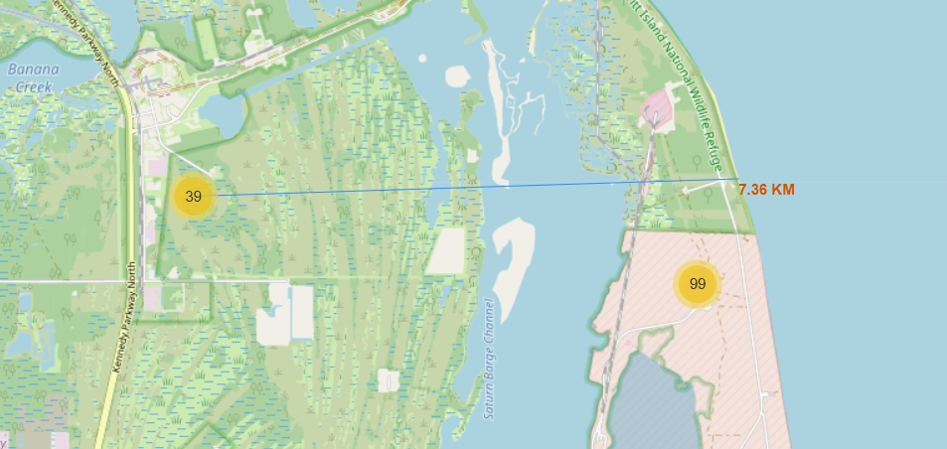
Proximity of the sites
This shows how one of the site is from the seashore

Slide 40

Section 4

Slide 41
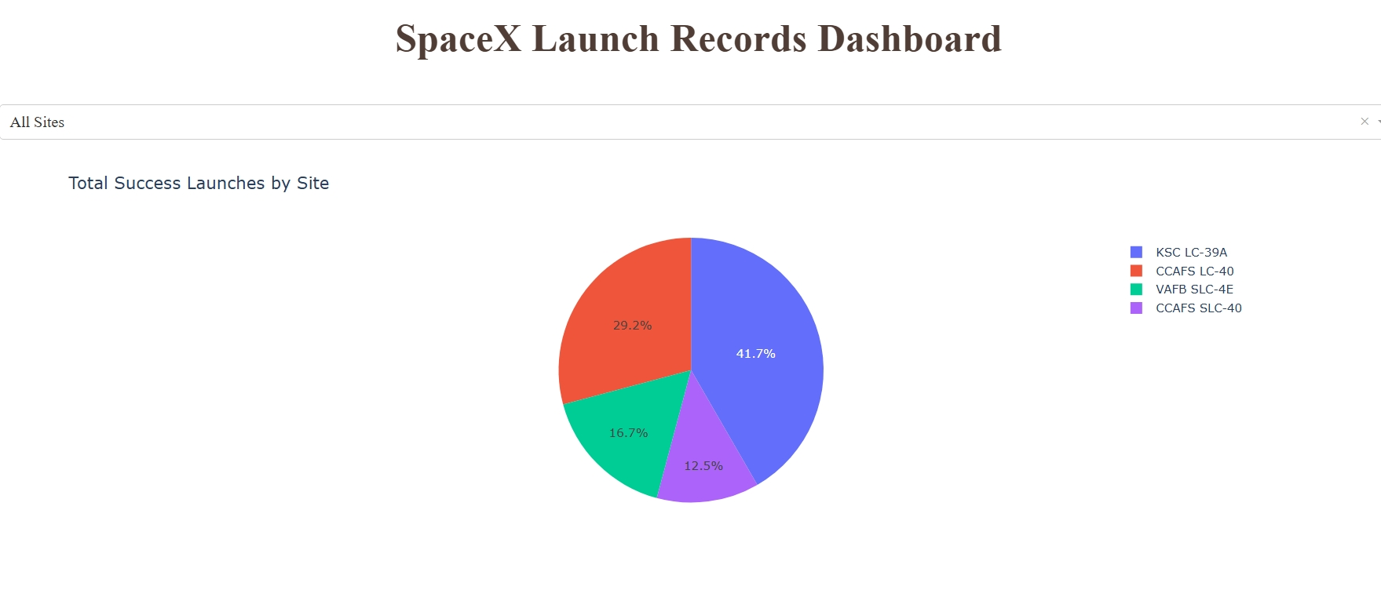
Space X Launch Records Dashboard
Shows that the overall success rate is high for KSC LC-39A but only few launches were done on that site with a rate of 43.7% when all the payload range was considered

Slide 42
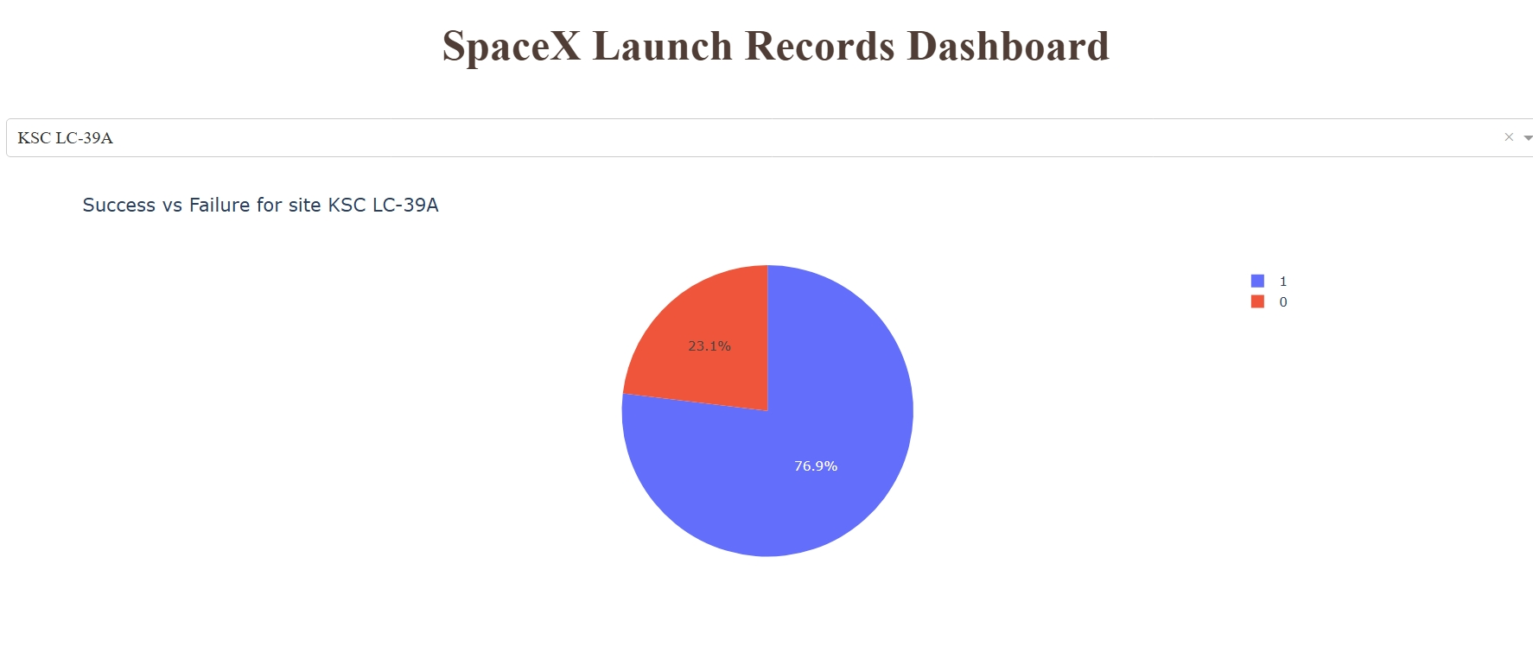
Dashboard with highest launch success ratio
The highest launch success ratio is for LSC LC-39A with 76.9% success and 23.1% faliure

Slide 43
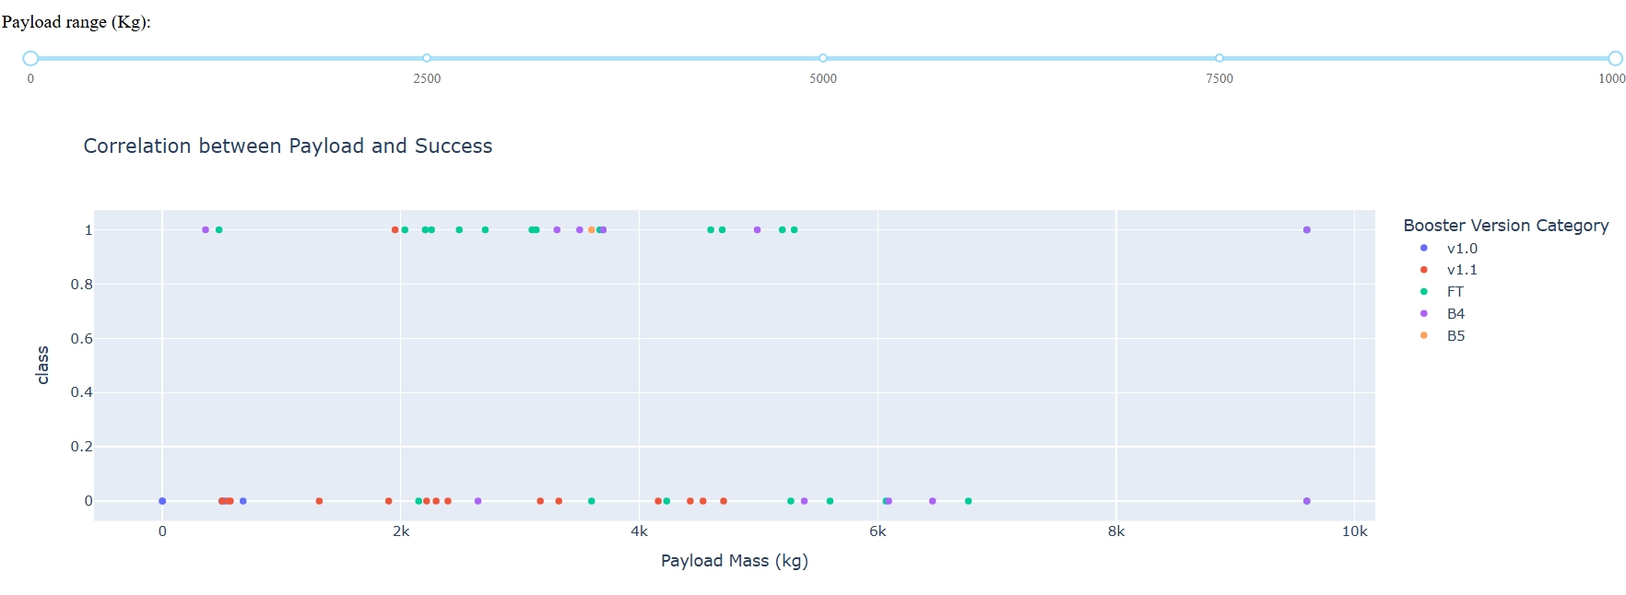
Dashboard of Payload vs Launch Outcome scatter plot
The payload between the range of 2000 to 6000 shows highest success rate.
FT booster version is much more promising

Slide 44

Section 5

Slide 45
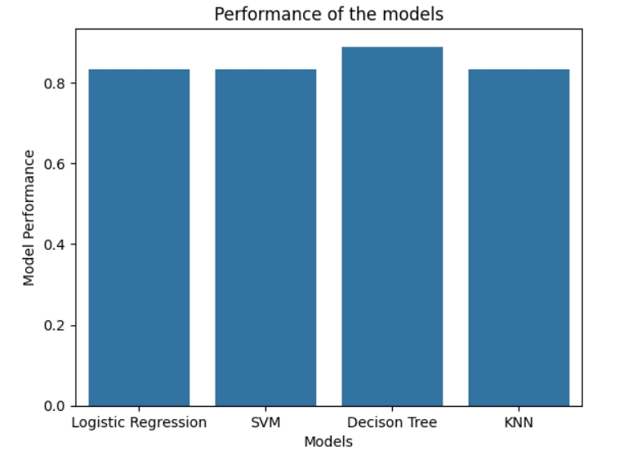
Classification Accuracy
The bar plot shows the performance of the models
Decision Tree model had the highest accuracy of all
Decision tree had an accuracy of 88.88%.

Slide 46
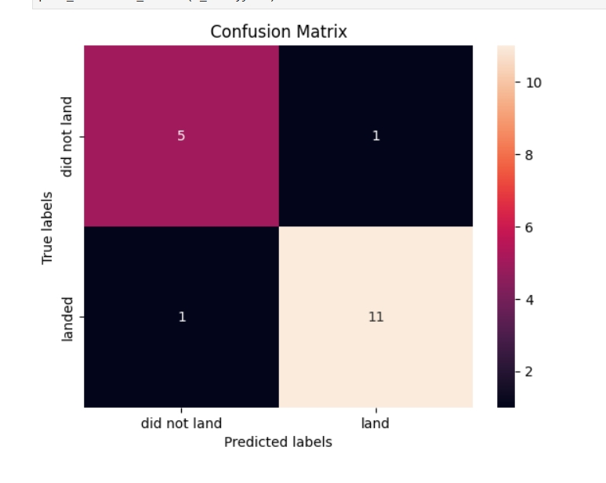
Confusion Matrix
The best performing model is Decision tree and the confusion matric of the model is:
Better classification of True Negative and True Positive

Slide 47
Conclusions
KSC LC 39 A launch site shows the highest success rate
The payload value between 4000 and 6000 is ideal for a successful launch
Decision tree model is the best performing model with an accuracy of 88.88% in test and 87.4% in train data.

Slide 48


